Slide 1




Lahari Kumaraswamy, Intern –Data Science, Flip Robo Technologies
Rating Prediction

Slide 2
Contents
1.Introduction
2.PreProcessing Steps
3.Libraries Used
4.Visualizations
5.Conclusion

Slide 3
Introduction
The rise in E — commerce, has brought a significant rise in the
importance of customer reviews. There are hundreds of review sites
online and massive amounts of reviews for every product. Customers
have changed their way of shopping and according to a recent survey, 70
percent of customers say that they use rating filters to filter out low
rated items in their searches.

Slide 4
Importance of reviews and rating
Ratings and reviews impact everything from sales to SEO.
Ratings and reviews help shoppers make informed, confident
purchases.
Reviews improve your brand’s trustworthiness.
Reviews contain insights about products, processes, and
purchasers.
Better Understanding of Customers & Improve Customer Service.
Credibility & Social Proof.
Fight with experience to save margins.
Allow Consumers to Have a Voice and Create Customer Loyalty.
Improve Rankings
Consumers are Doing your Marketing for Business.
Reviews Generate More Reviews

Slide 5
PreProcessing steps
1.Converting text into lower case
2.Removing Punctuations
3.Removing Stopwords
4.Lemmatization
5.Tokenization

Slide 6
Libraries Used
1. import selenium
2. import pandas as pd
3. from selenium import webdriver
4. from selenium.common.exceptions import NoSuchElementException
5. import time
6. import numpy as np
7. import pandas as pd
8. import seaborn as sns
9. import warnings
10. warnings.filterwarnings('ignore')
11. from wordcloud import WordCloud
12. import matplotlib.pyplot as plt
13. import nltk
14. from nltk.corpus import stopwords
15. from collections import Counter
16. from nltk.stem import PorterStemmer, WordNetLemmatizer
17. from nltk.corpus import wordnet
18. from nltk.stem import WordNetLemmatizer
19. import tensorflow as tf
20. import numpy as np
21. from tensorflow.keras.preprocessing.text import Tokenizer
22. from tensorflow.keras.preprocessing.sequence import pad_sequences
23. from sklearn.model_selection import train_test_split

Slide 7
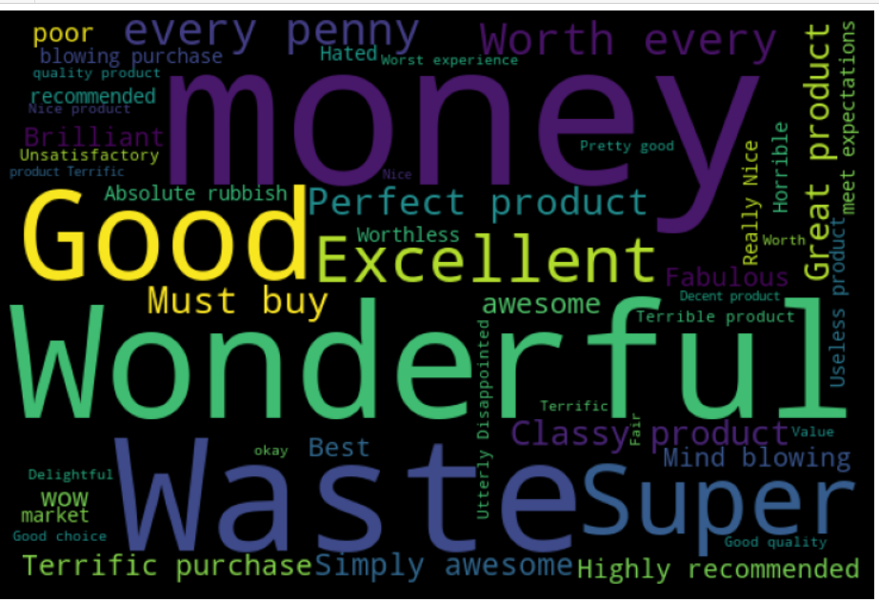
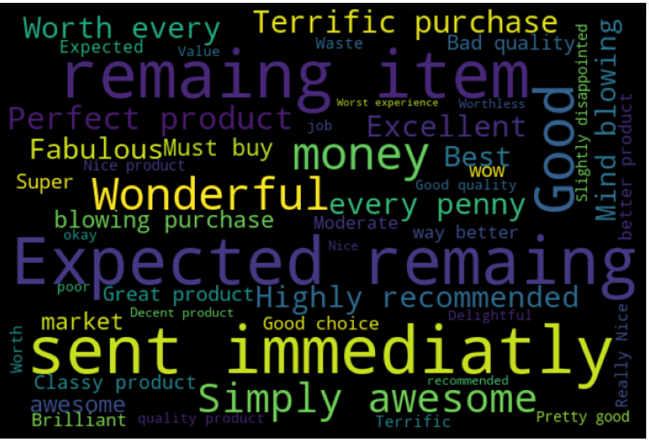
Visualization

Slide 8
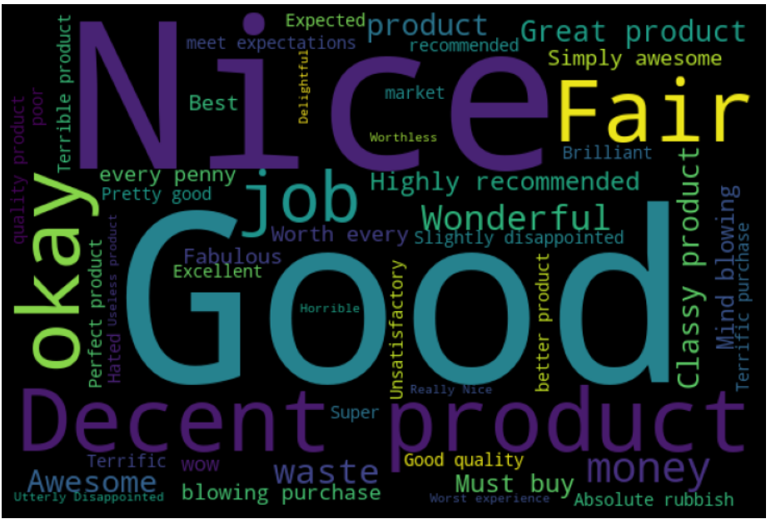
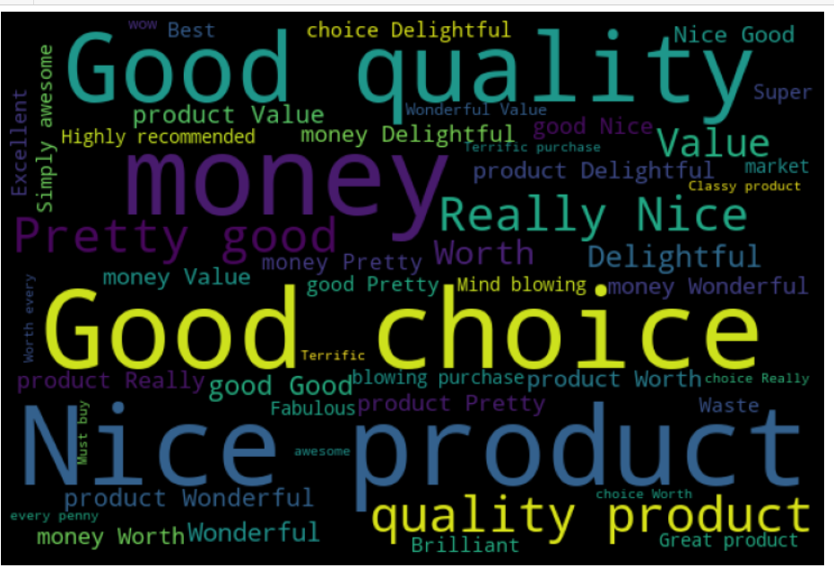
Visualization continued

Slide 9
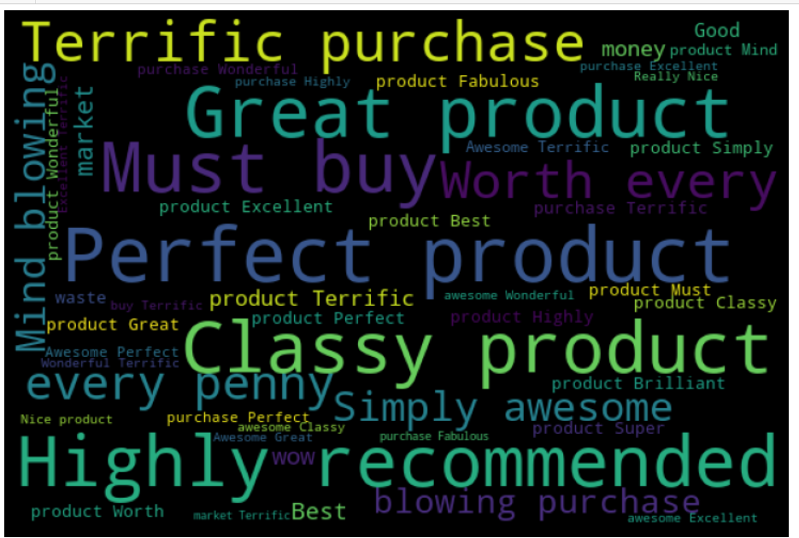

Slide 10
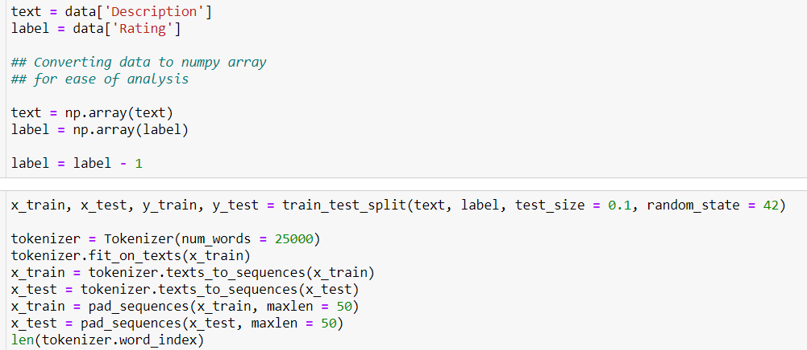
Code Snippet

Slide 11
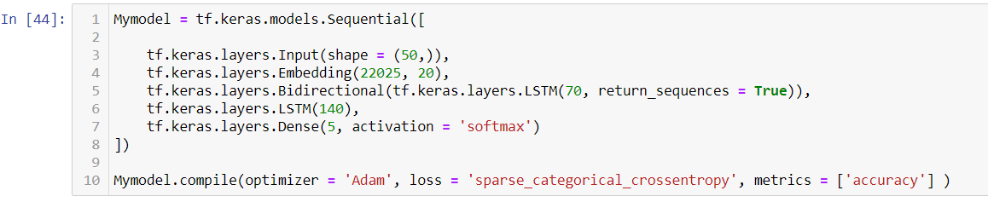
Code Snippet Continued

Slide 12
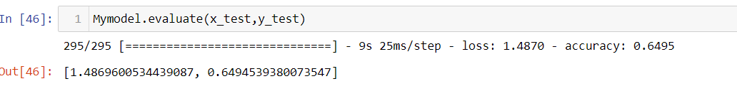
Finale Metrics

Slide 13
Thank You
Notes:
You can use this slide as your opening or closing slide. Should you choose to use it as a closing, make sure you review the main points of your presentation. One creative way to do that is by adding animations to the various graphics on a slide. This slide has 4 different graphics, and, when you view the slideshow, you will see that you can click to reveal the next graphic. Similarly, as you review the main topics in your presentation, you may want each point to show up when you are addressing that topic.
Add animation to images and graphics:
Select your image or graphic.
Click on the Animations tab.
Choose from the options. The animation for this slide is “Split”. The drop-down menu in the Animation section gives even more animations you can use.
If you have multiple graphics or images, you will see a number appear next to it that notes the order of the animations.
Note: You will want to choose the animations carefully. You do not want to make your audience dizzy from your presentation.

